Slide 1

Mehrad Haghshenas
SCICOMP301 Topics in Computer Science
Project 1: Petri Nets
“This is all my own work. I have not knowingly allowed others to copy our work. This work has not been submitted for assessment in any other context.”

Slide 2
Technology Platform
Hardware: macOS Monterey (Version 12.2.1)
Software: PIPE (PIPE-gui-5.0.2.jar) under JAVA 8 (1.8.0_202.jdk)
Side Note: the CPN tools official website recommend not installing CPN for mac instead installing the latest windows version and using virtual machines to use the tool.

Slide 3
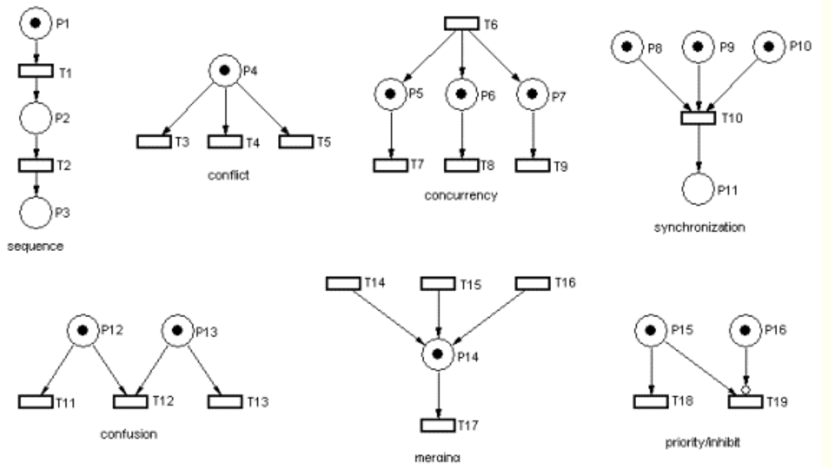
Basic Petri Nets
History: introduced by German Mathematician Carl Adam Petri.
Formal Definition:
graphical and mathematical modelling framework
bipartite directed graph (places and transitions == Nodes).
Five-tuple (P, T, I, O,M). (I/O == Edges).
M: a m-tuple of the number of tokens (dynamic)
Restricted condition: No two places or two transitions can be connected.
https://www.techfak.uni-bielefeld.de/~mchen/BioPNML/Intro/pnfaq.html

Slide 4
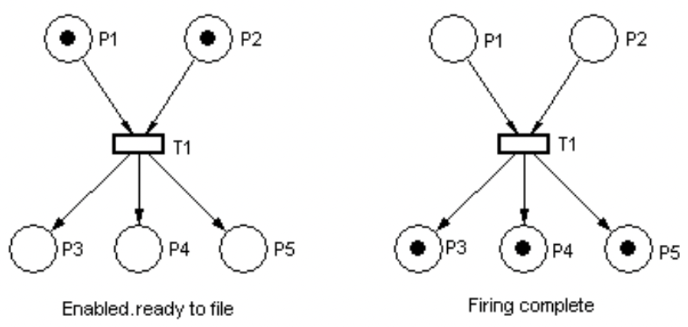
Terms DEfinitions
Marking == State: distribution of tokens in places.
state space: the set of all markings
reachability set: all markings that can be obtained from some initial marking
non-determinism: multiple transitions are enabled but not all can fire like
confusion, conflict …
Initial marking: M(0) = (1, 1, 0, 0, 0). After firing: M(1) = (0,0,1,1,1)

Slide 5
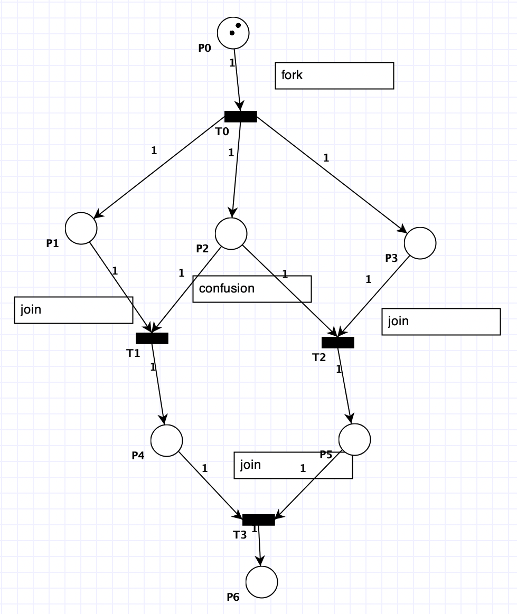
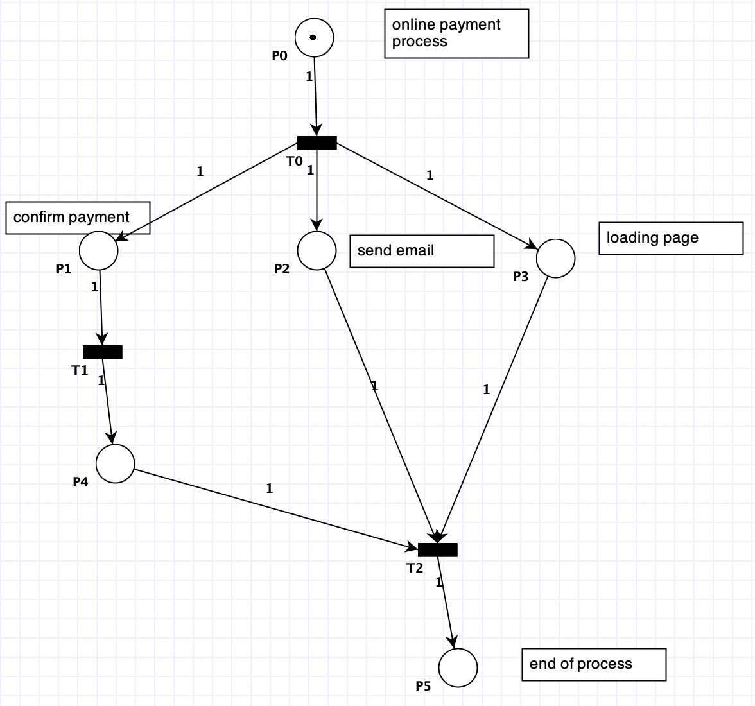
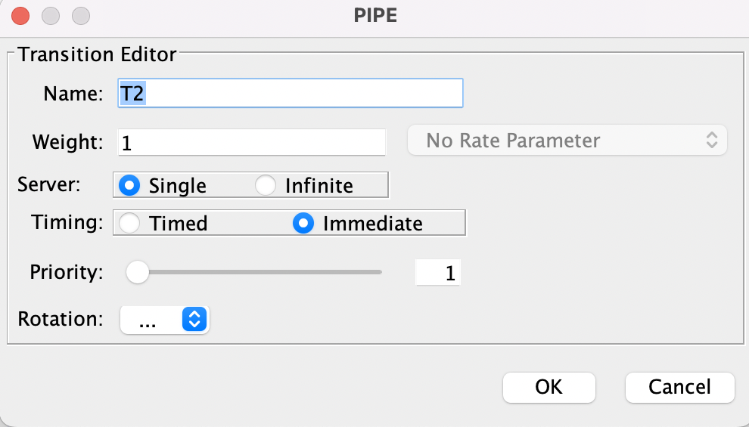
a fork and join example before transition firing.
Join in sychronization. Fork is concurrency.

Slide 6
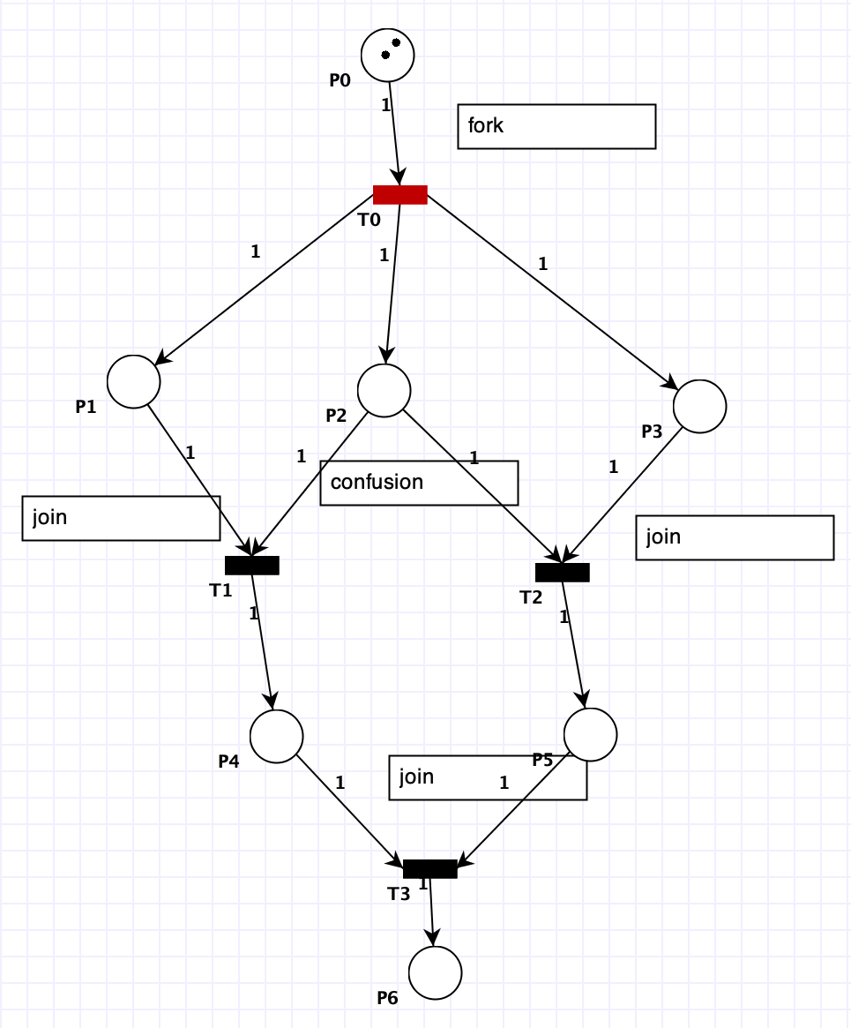
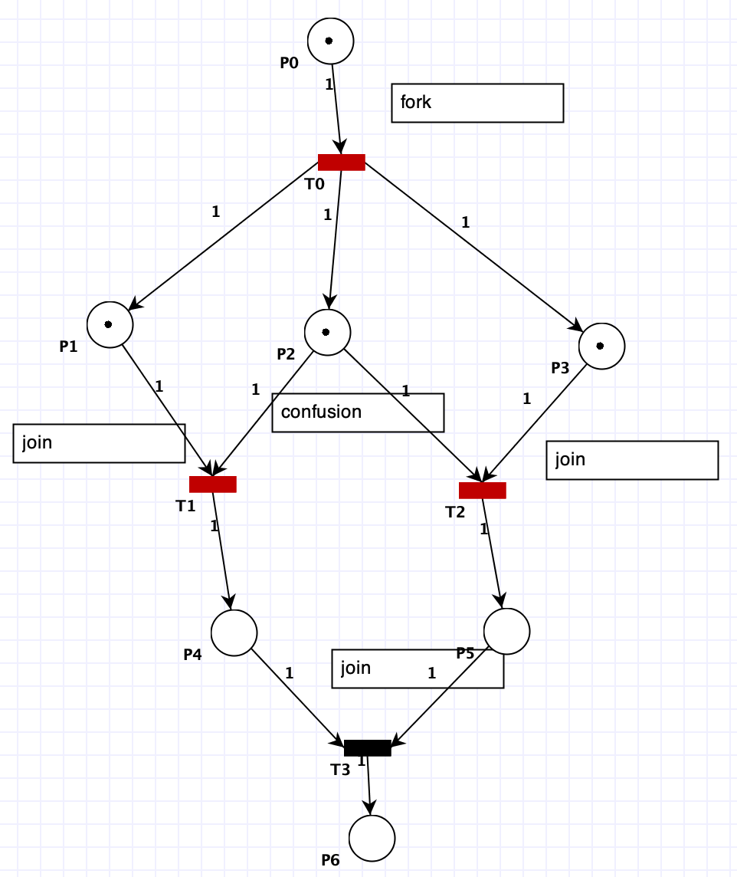
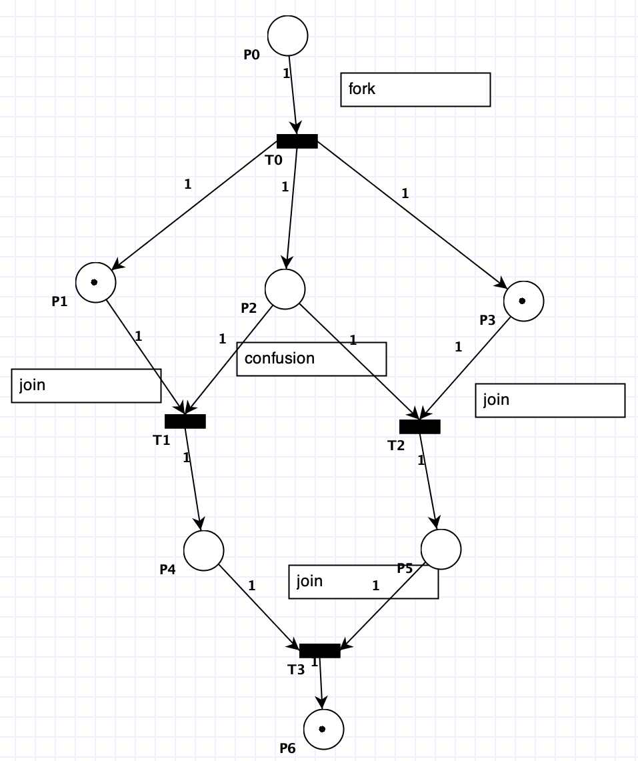
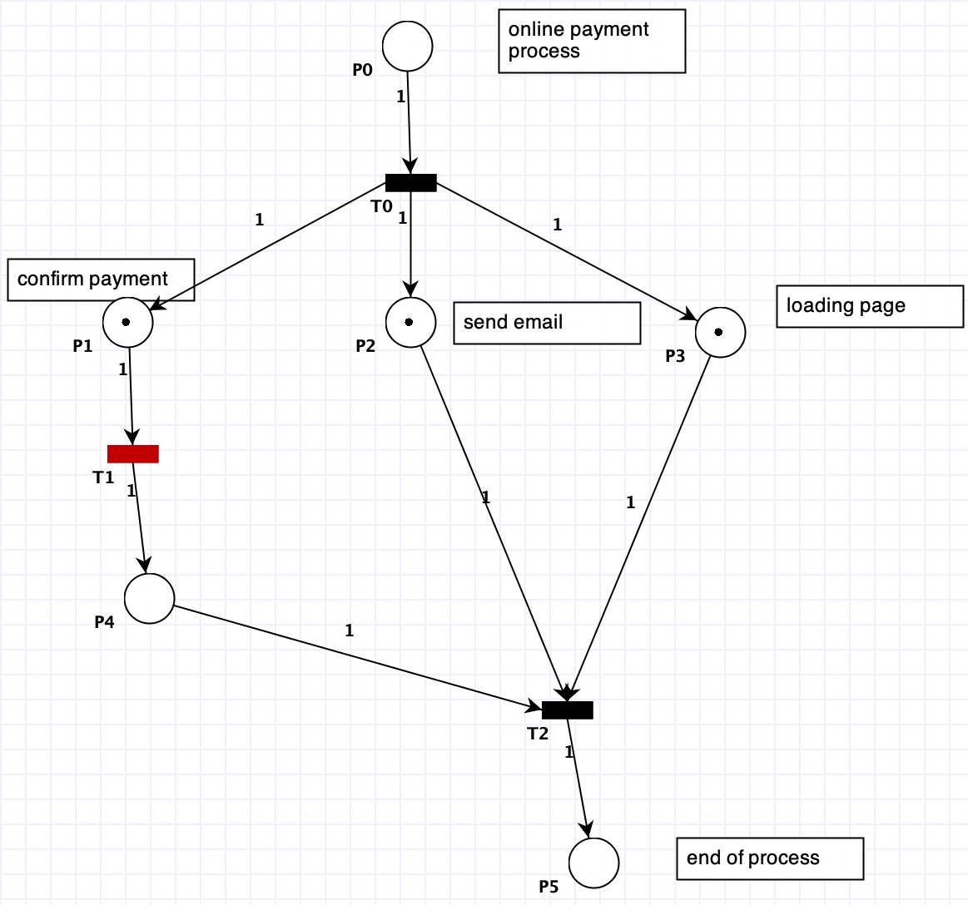
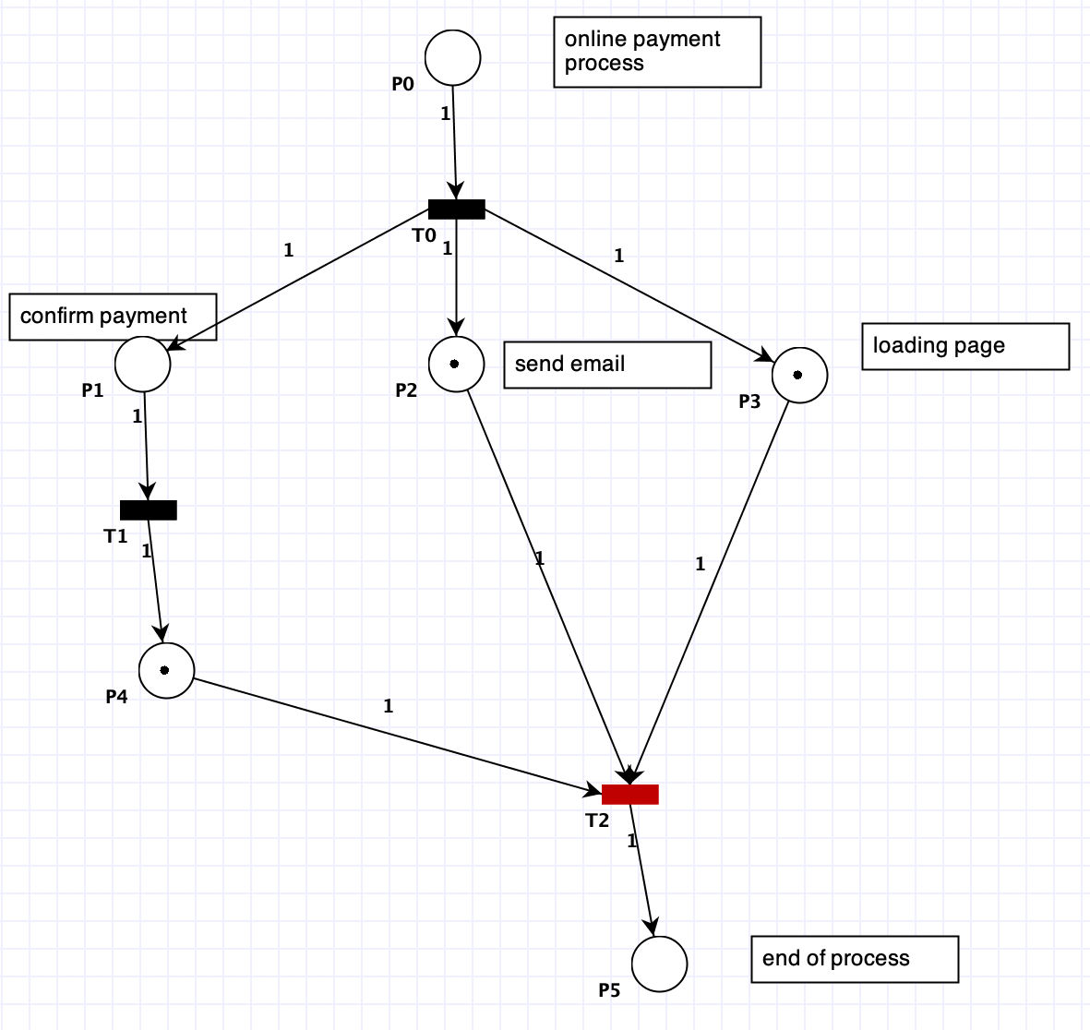
a fork and join example after transition firing

Slide 7
deadlock (Circular Waiting) problem
Problems in resource allocation --- CPU is the resource in OS.
scarcity of resources compared to places needs
“A Petri net is deadlocked iff no transitions are enabled.” (https://citeseerx.ist.psu.edu/viewdoc/download?doi=10.1.1.136.4482&rep=rep1&type=pdf )
A petri Net is deadlocked if the state of the petri does not change after transition. https://www.youtube.com/watch?v=aNnTEeLeMCw&t=979s
Mutual Exclusion: Non shareable resources
Hold and Wait: A process is holding at least one resource and waiting for resources.
No Pre-emption: A resource cannot be taken from a process
Circular Wait: (Waiting for and Assigned to)

Slide 8
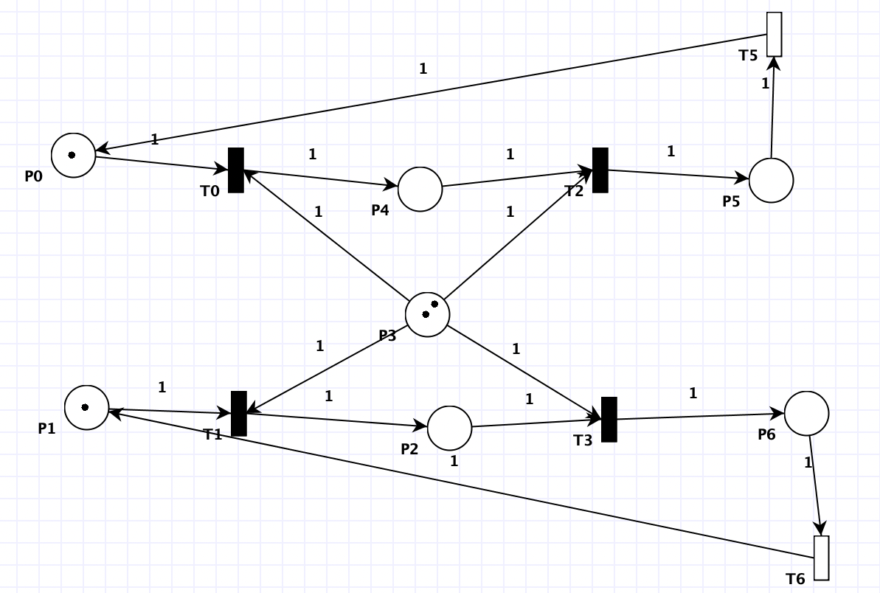
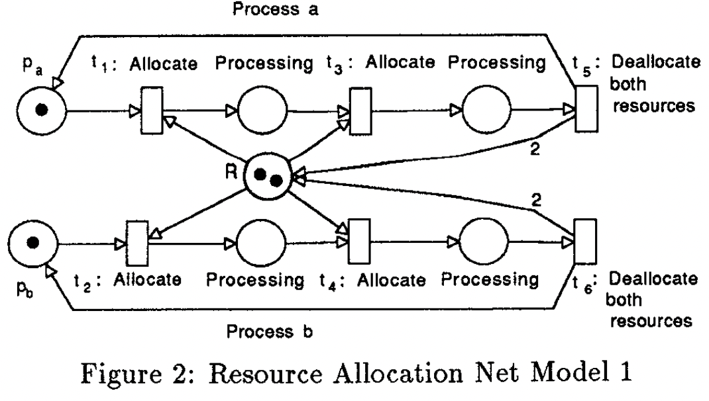
a Petri Net for illustrating deadlock with an initial marking of tokens.
https://citeseerx.ist.psu.edu/viewdoc/download?doi=10.1.1.136.4482&rep=rep1&type=pdf
Which one is this?

Slide 9
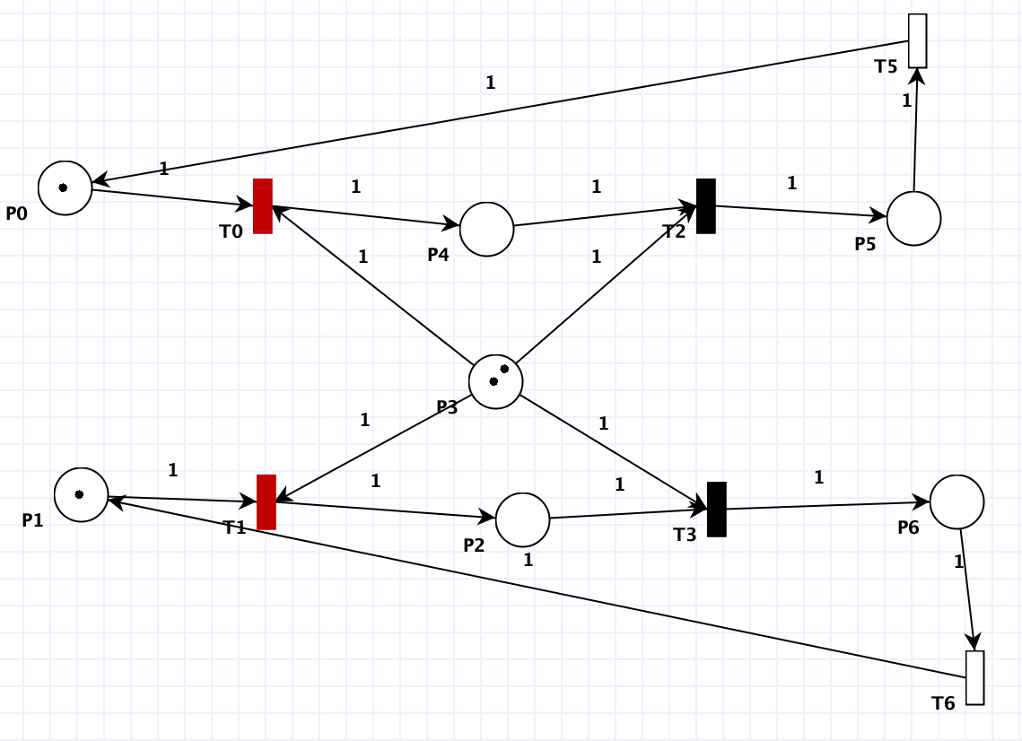
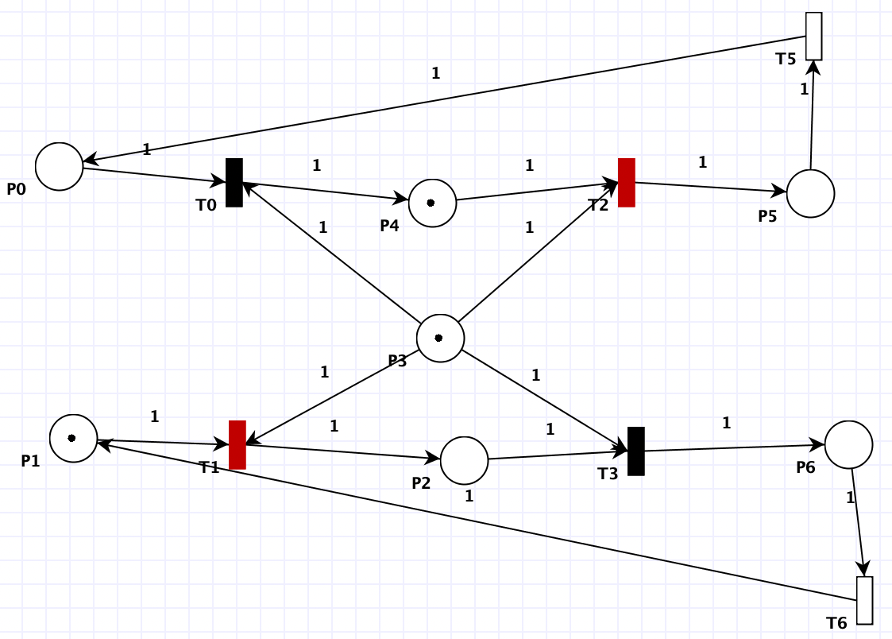
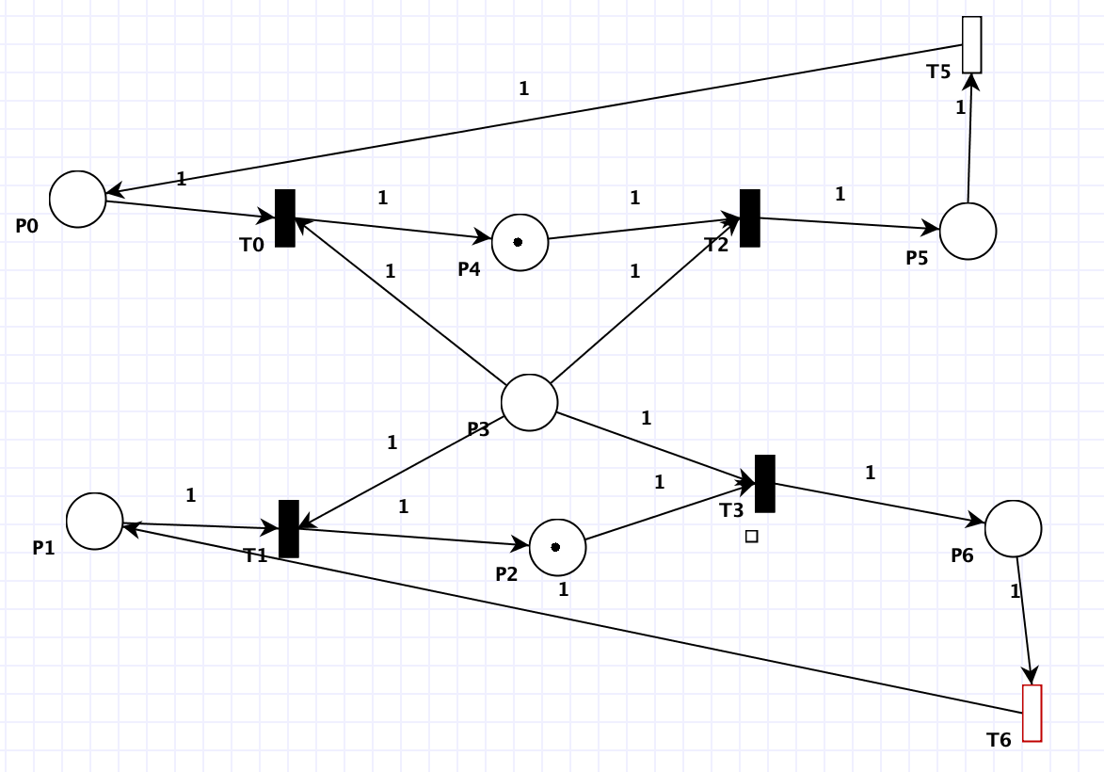
a Petri Net for illustrating deadlock after several steps have been executed
Step 1
Step 2
Step 3

Slide 10
Starvation (Live LOCK)
Scheduling Algorithms (FCFS,LCFS,SJF,LJF,RR,SRTF,LRTF,MQS…)
Starvation is related to priority scheduling
Priority Scheduling: 1- Highest priority executed first. 2- Same priority executed on FCFS
What can priorities be? time, memory, etc. (for example lowest burst time)
Starvation: a process ready for the CPU can wait to run indefinitely because of low priority. (always waiting to run) (Example IBM 7094).
Difference between Starvation & Deadlock? 1- resources 2- transitions except for the victim.
Solution to Starvation: Aging

Slide 11
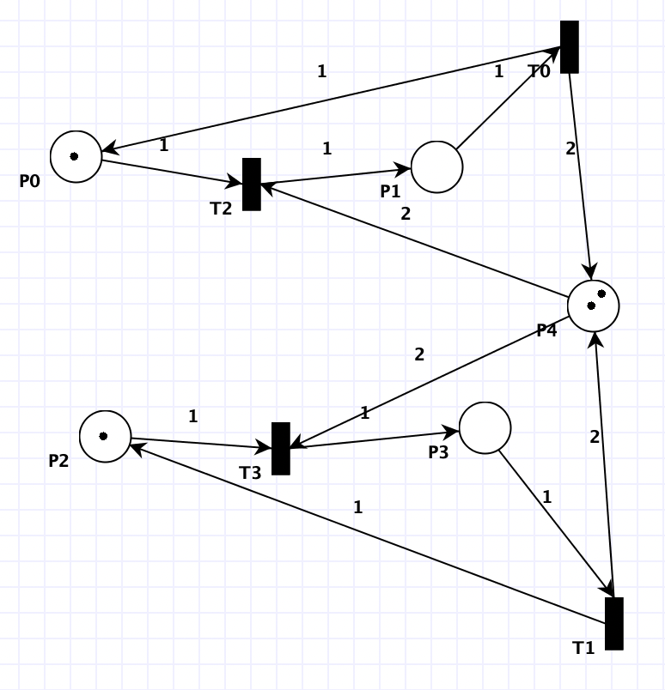
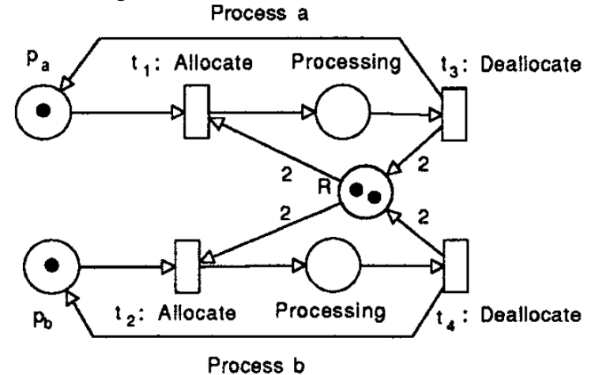
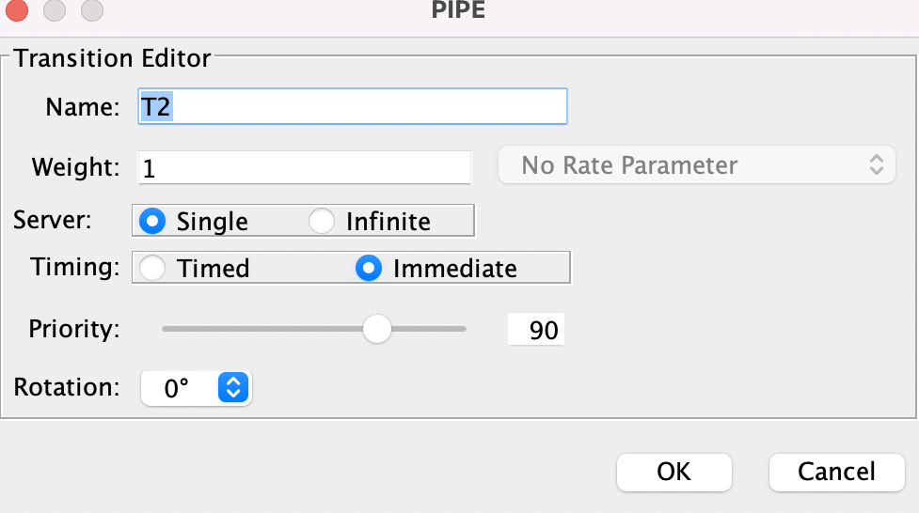
a Petri Net illustrating starvation with an initial marking of tokens.

Slide 12
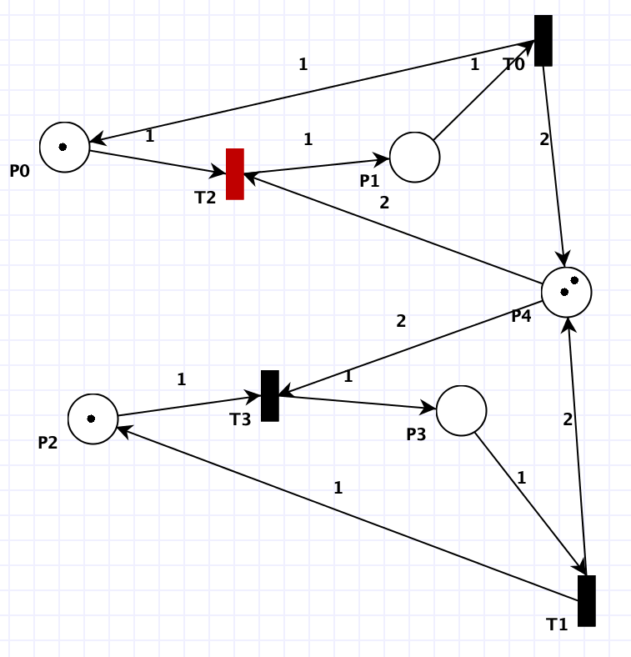
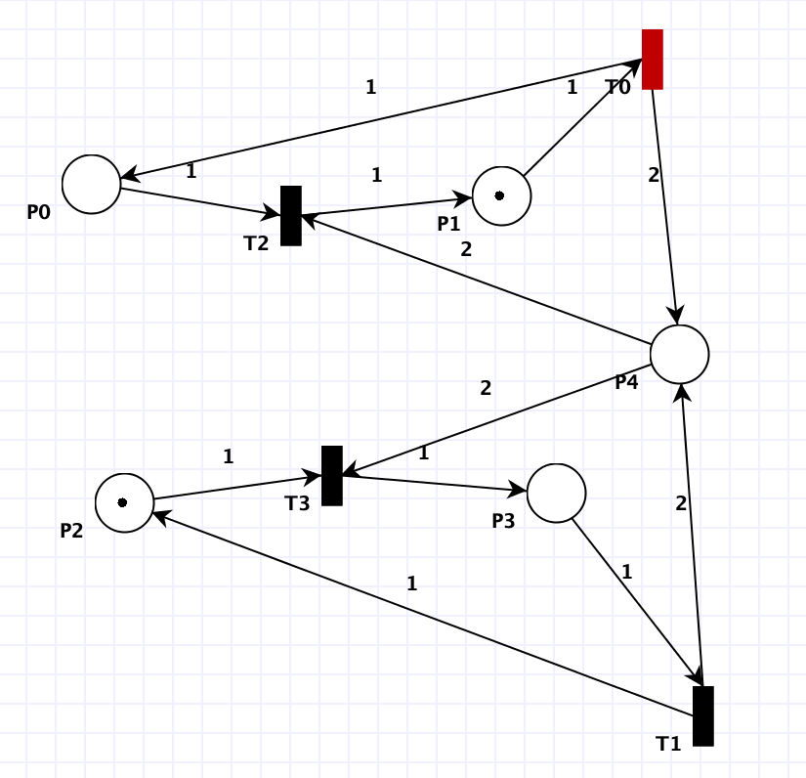
a Petri Net illustrating starvation after several steps have been executed.
Step 1
Step 2

Slide 13
Producer-Consumer problem
a multi-process synchronization
Two processes: 1- Producer 2- Consumer
share a fixed-size buffer (generating data to the buffer and using it)
Problem: making sure that:
1- the producer can’t generate data into the buffer when full
2- The consumer can’t remove data from an empty buffer.
Solution
Sleeping (idle) & Notifying (if notifying doesn’t happen: Deadlock)
Approach to Solution: Binary Semaphores, Critical Section, concurrency (python: import threading)

Slide 14
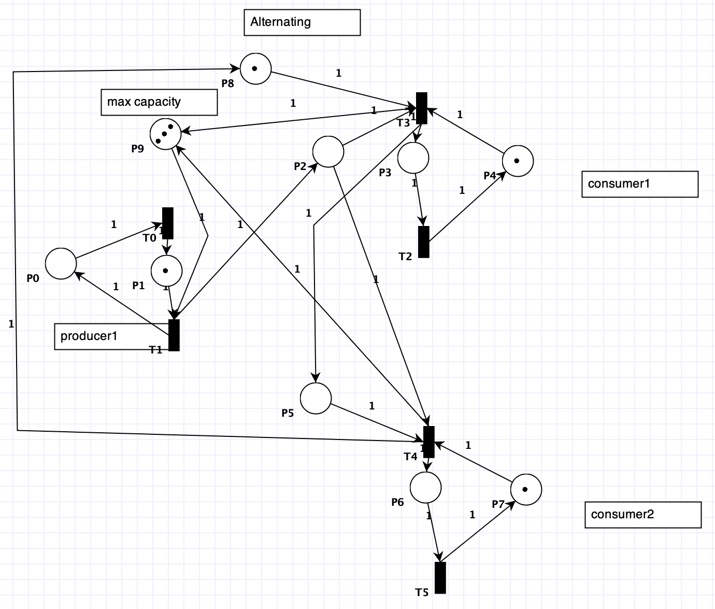
a Petri Net illustrating a solution to the Producer-Consumer problem
Consumer and producer insert and generate one at a time
Maximum capacity is 3
Alternating consumption.

Slide 15
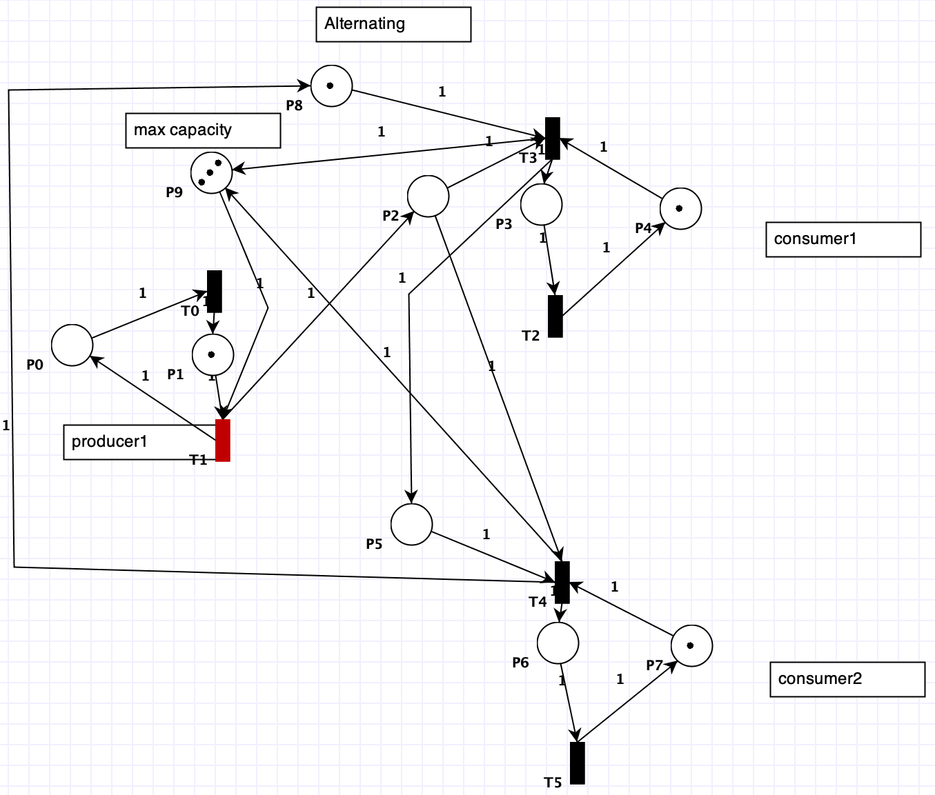
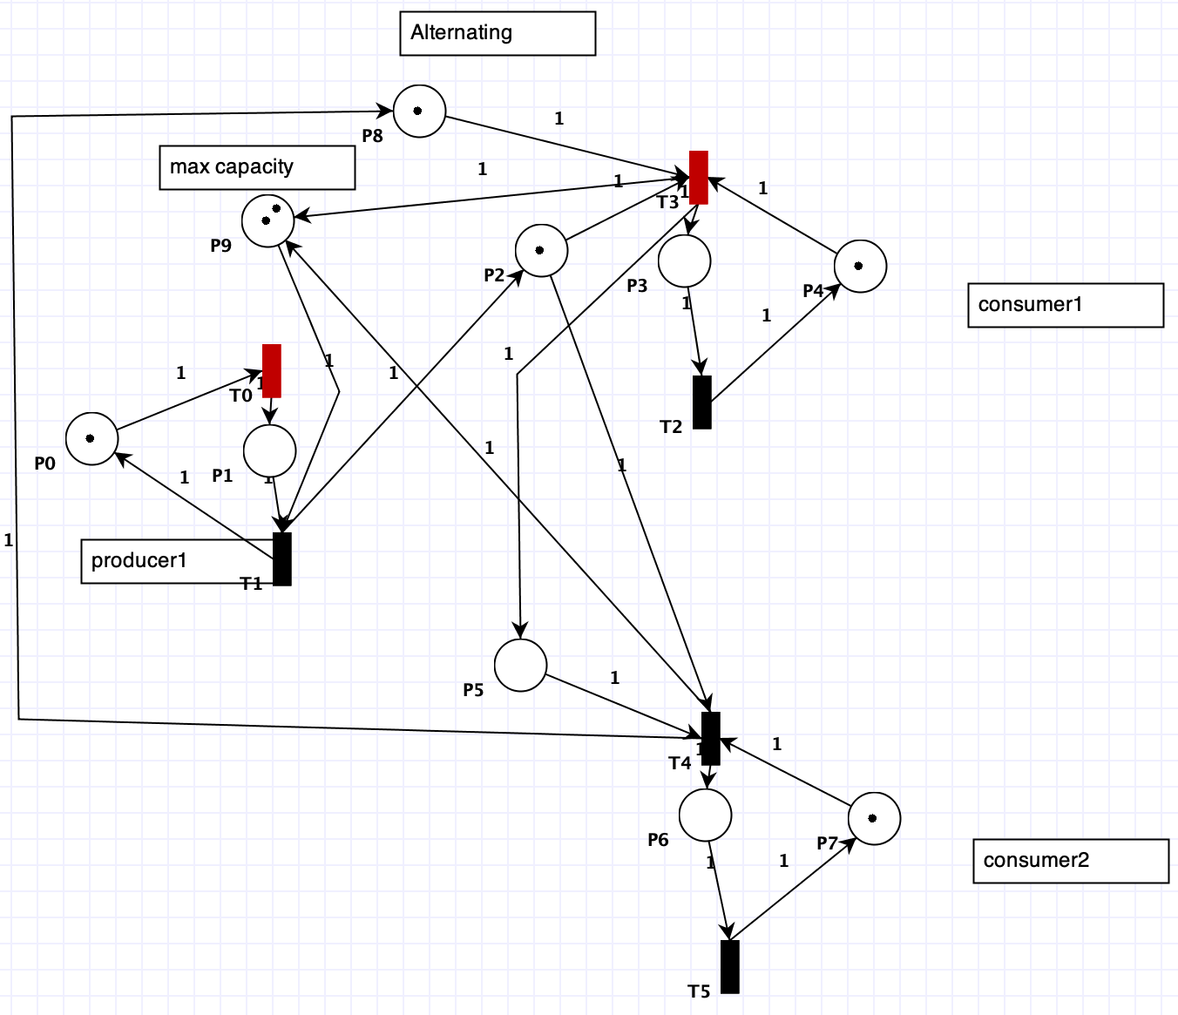
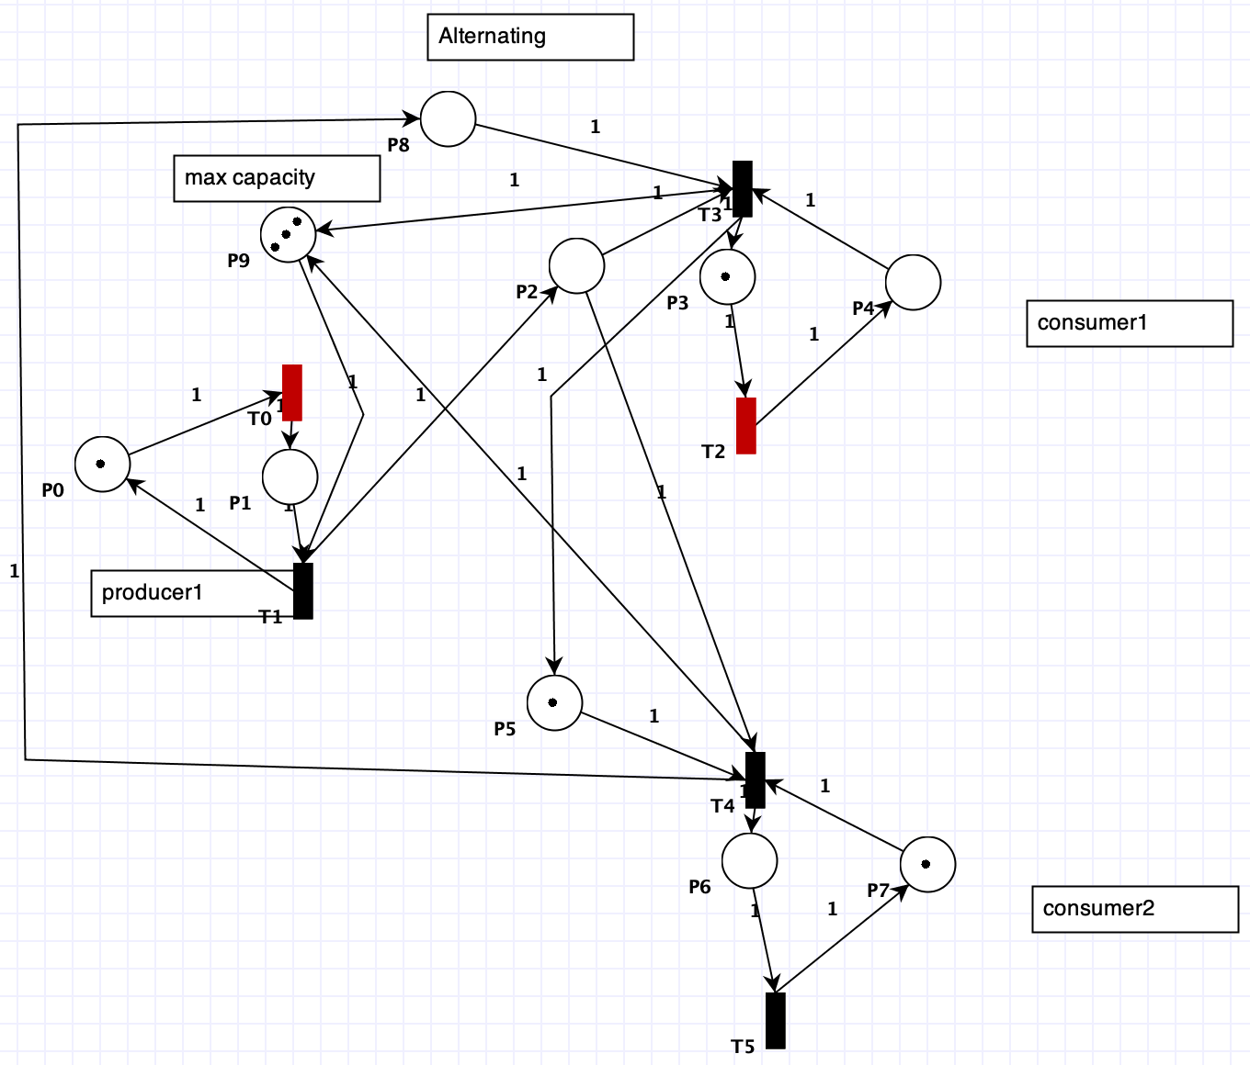
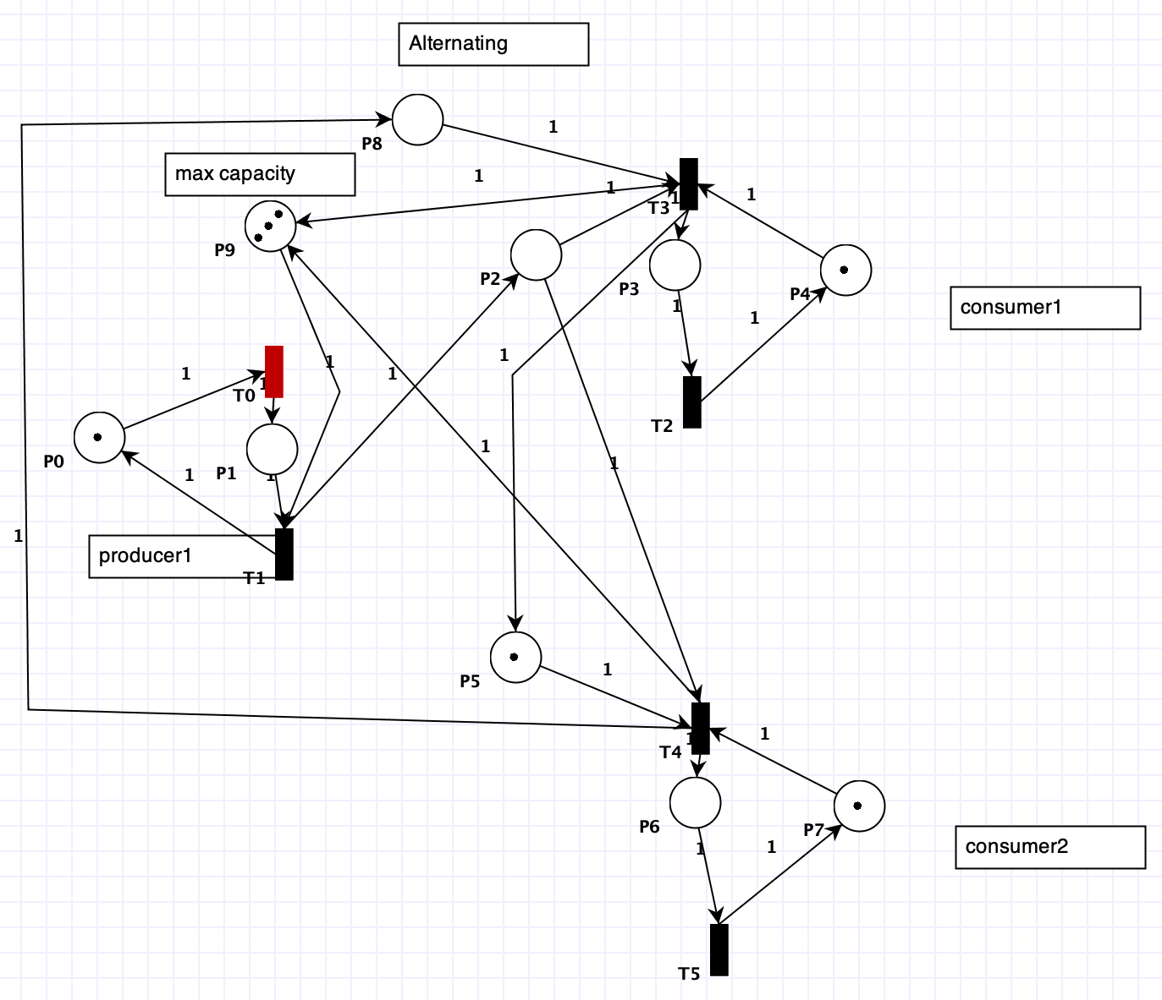
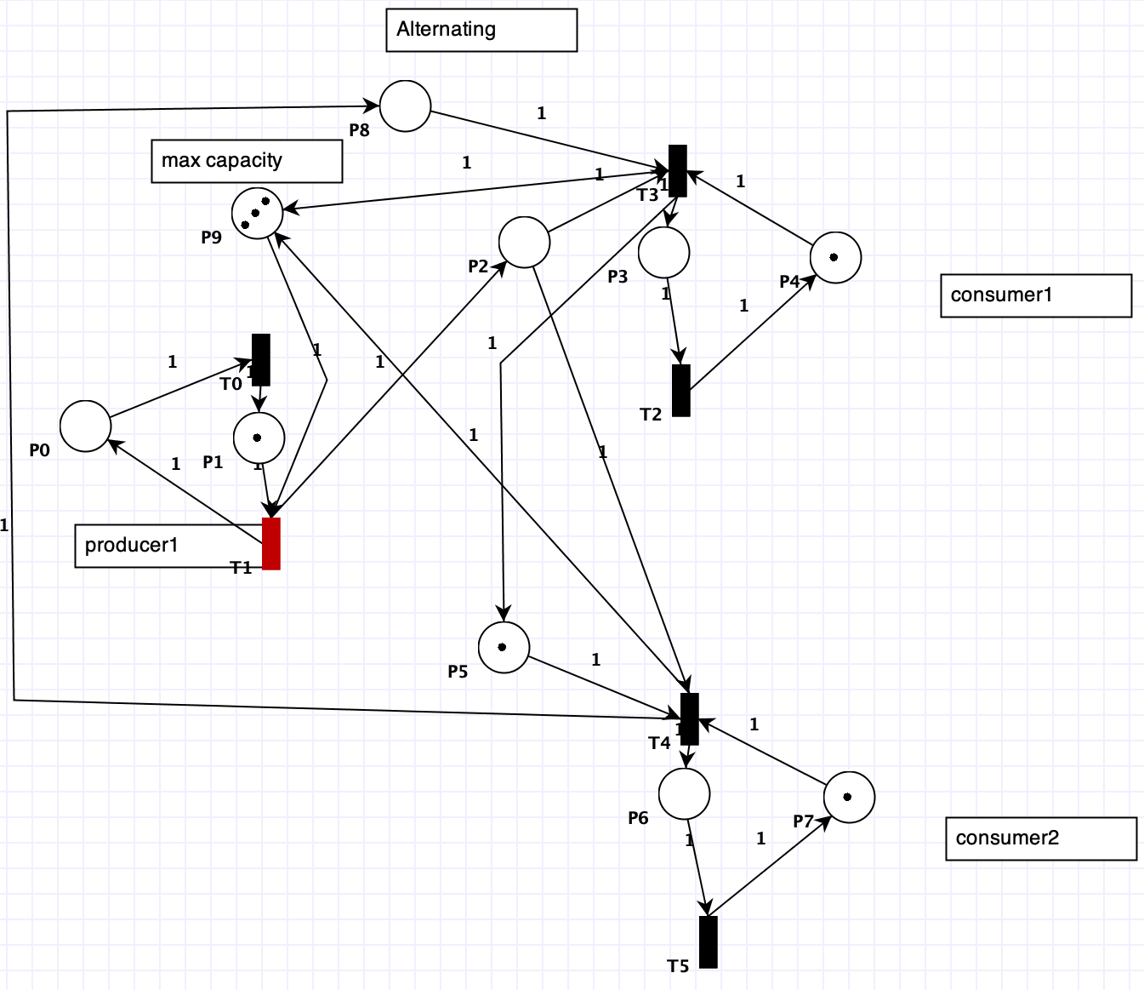
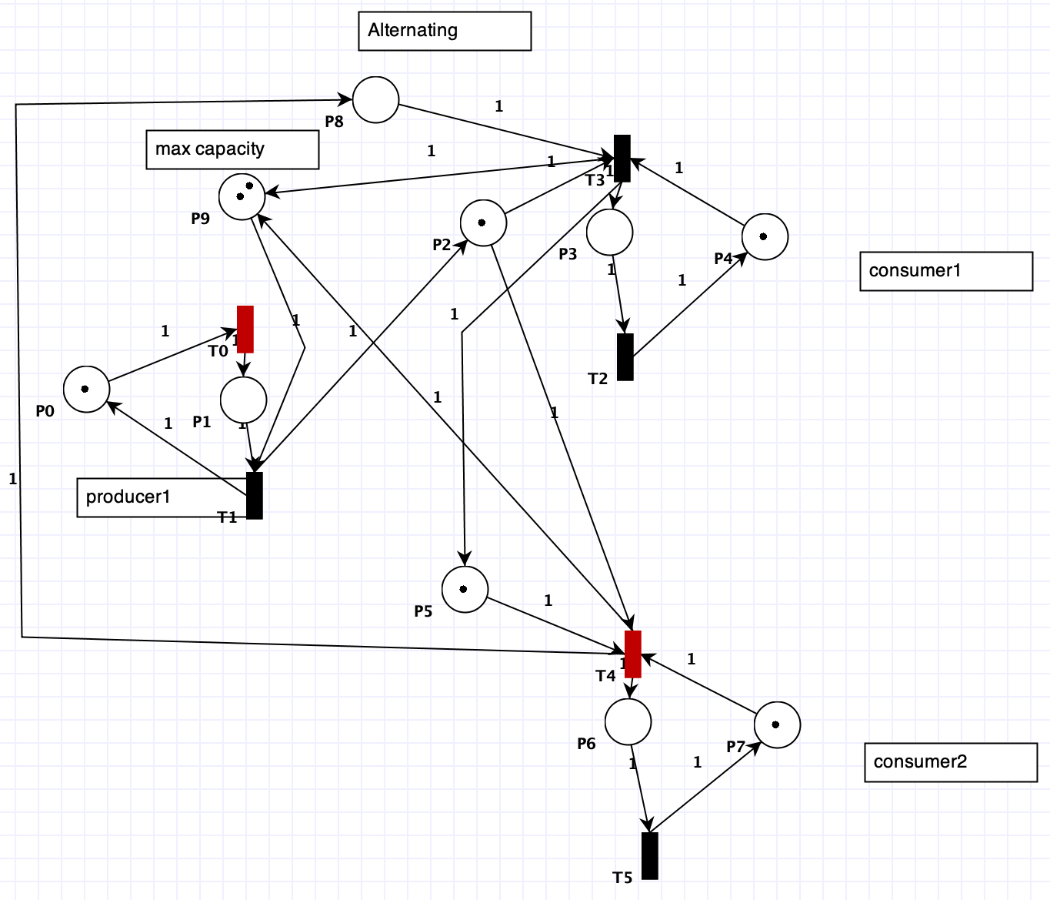
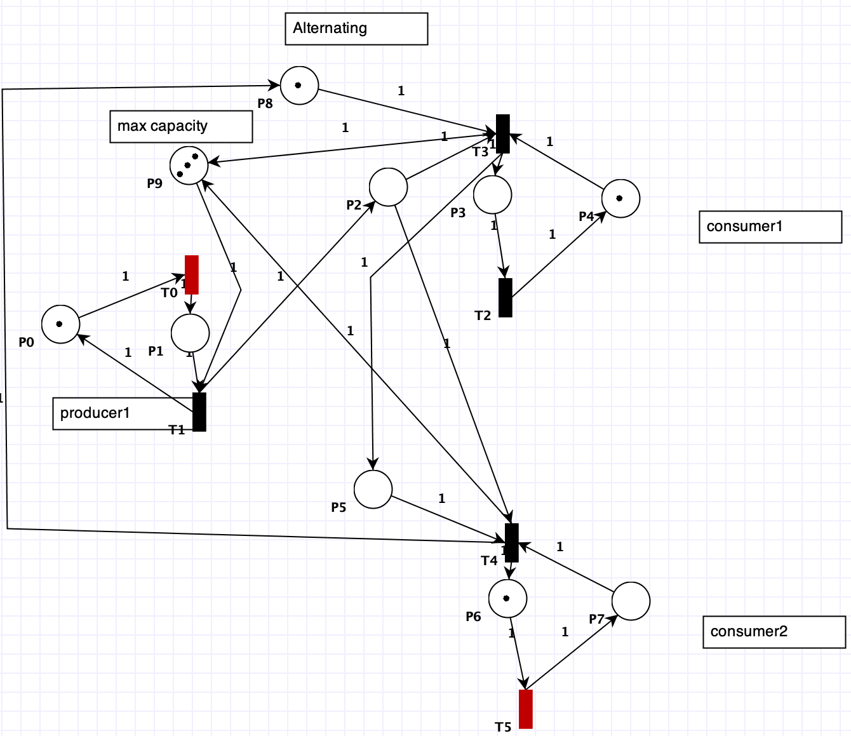
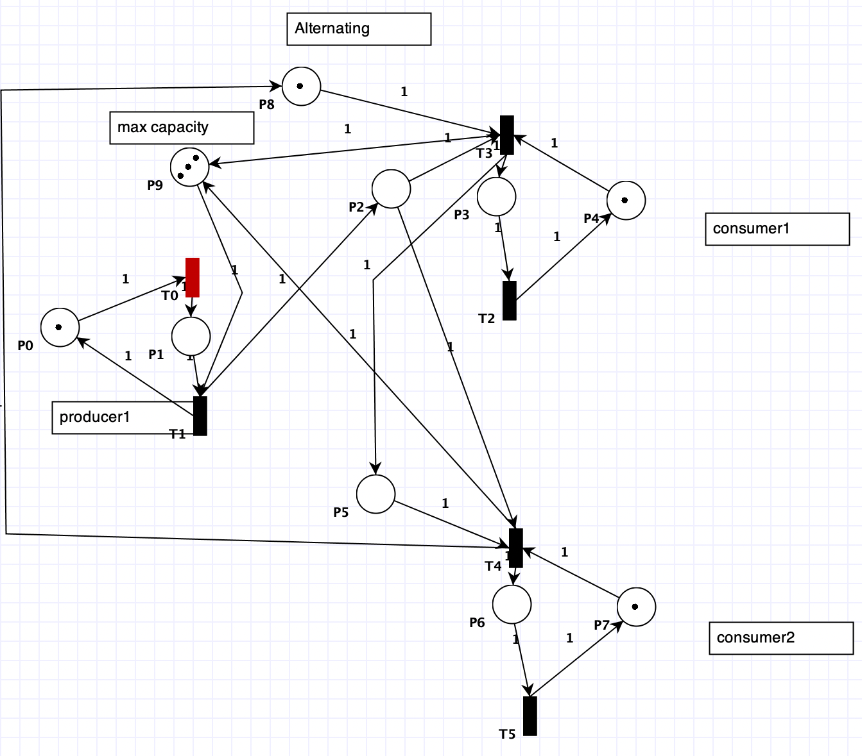
a Petri Net illustrating Producer-Consumer after several steps
Steps 1 to 8 from left to right and then top to bottom

Slide 16
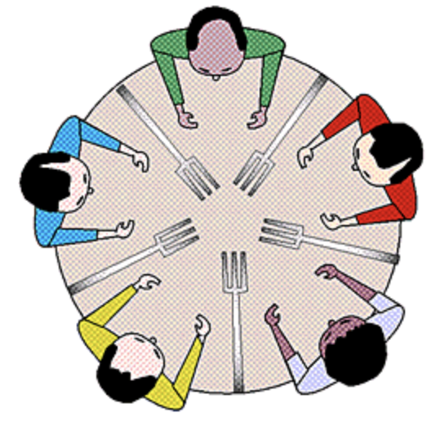
Dining Philosophers problem
N philosophers sharing n chopsticks around the table
chopsticks are located in-between philosophers
A philosopher is either in state eating or thinking and needs two chopsticks to eat.
https://www.javatpoint.com/os-dining-philosophers-problem

Slide 17
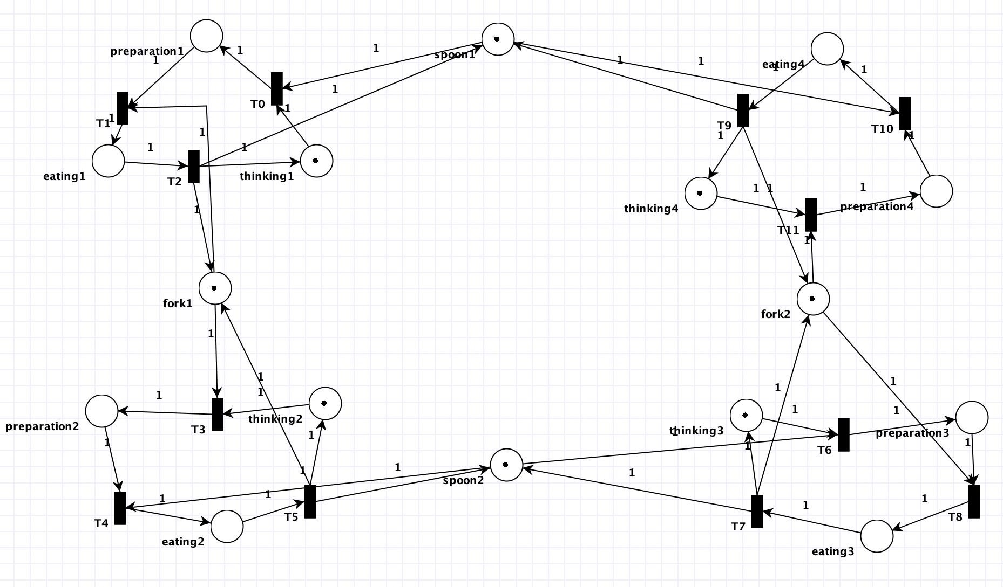
a Petri Net illustrating a solution to the Dining Philosophers problem

Slide 18
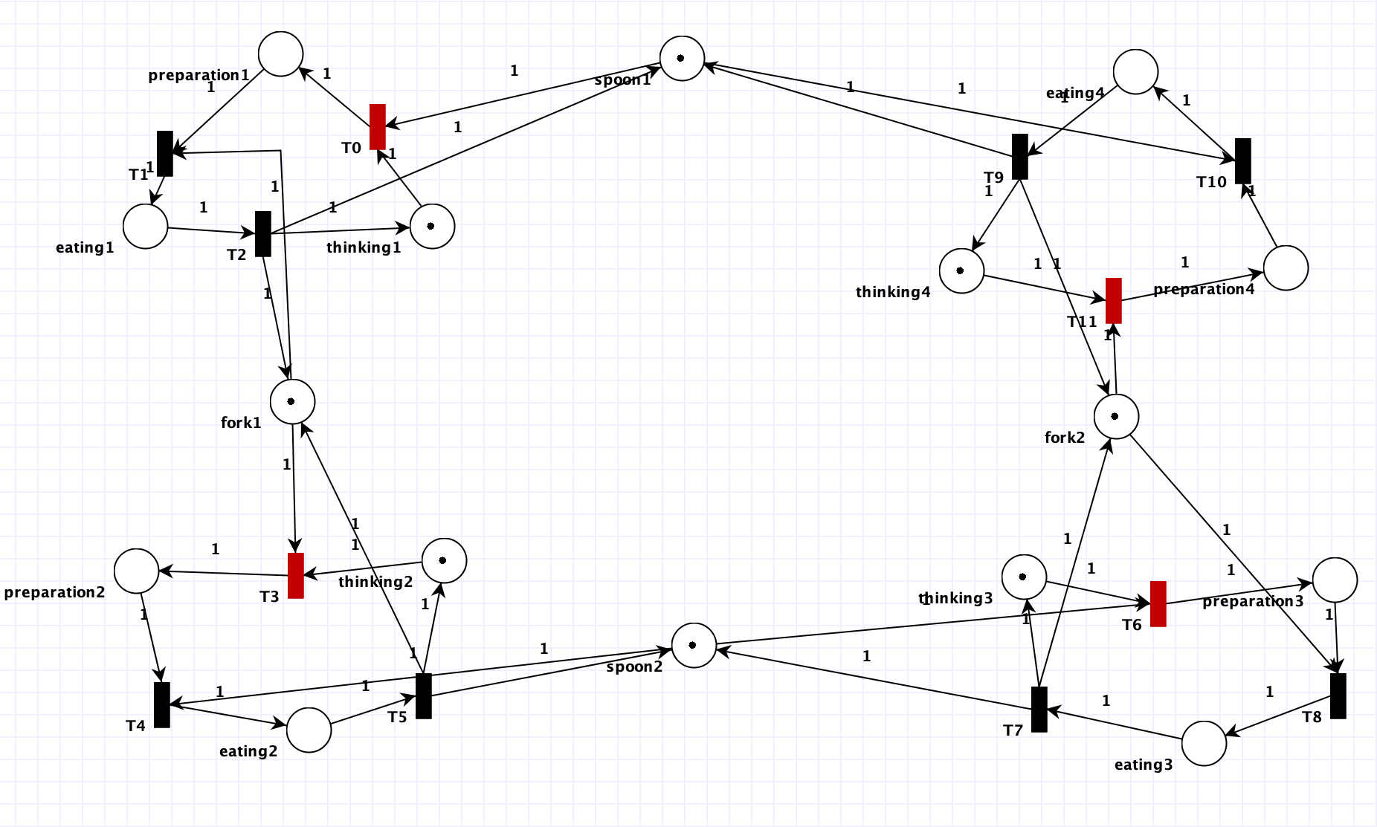
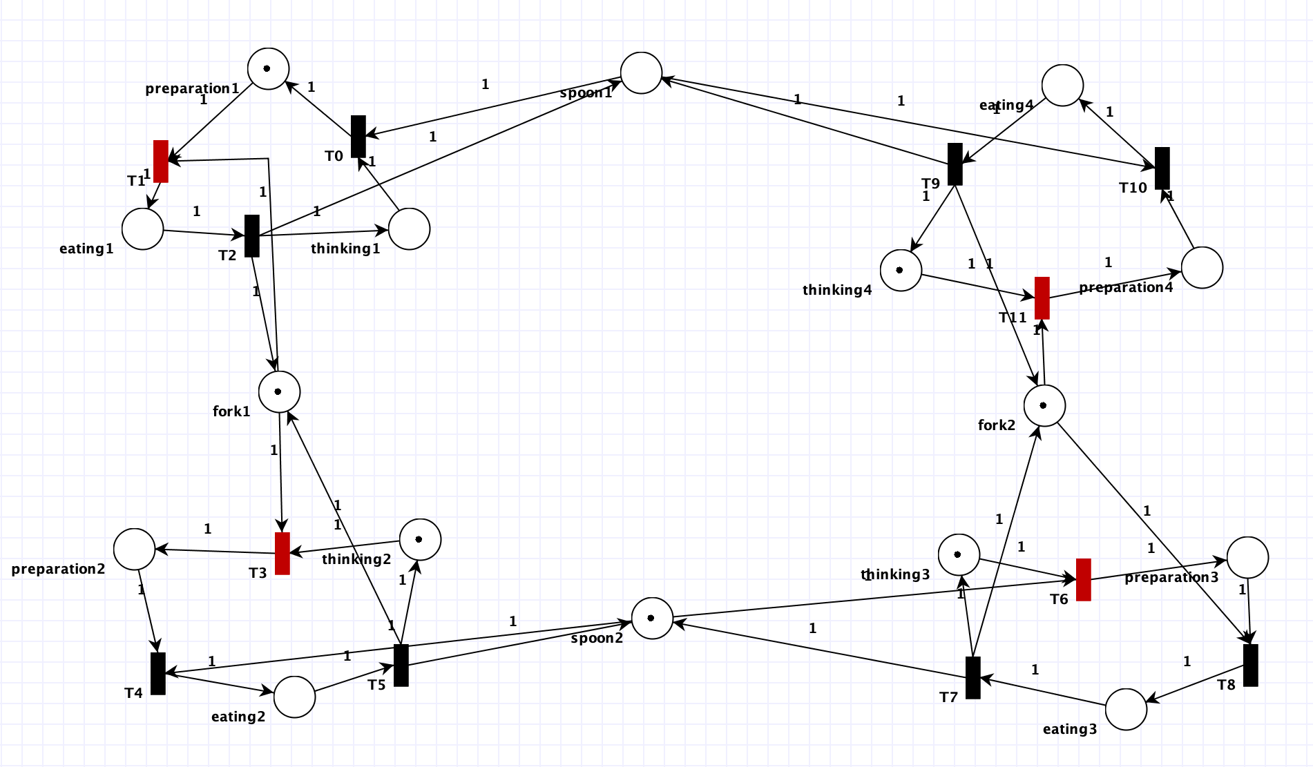
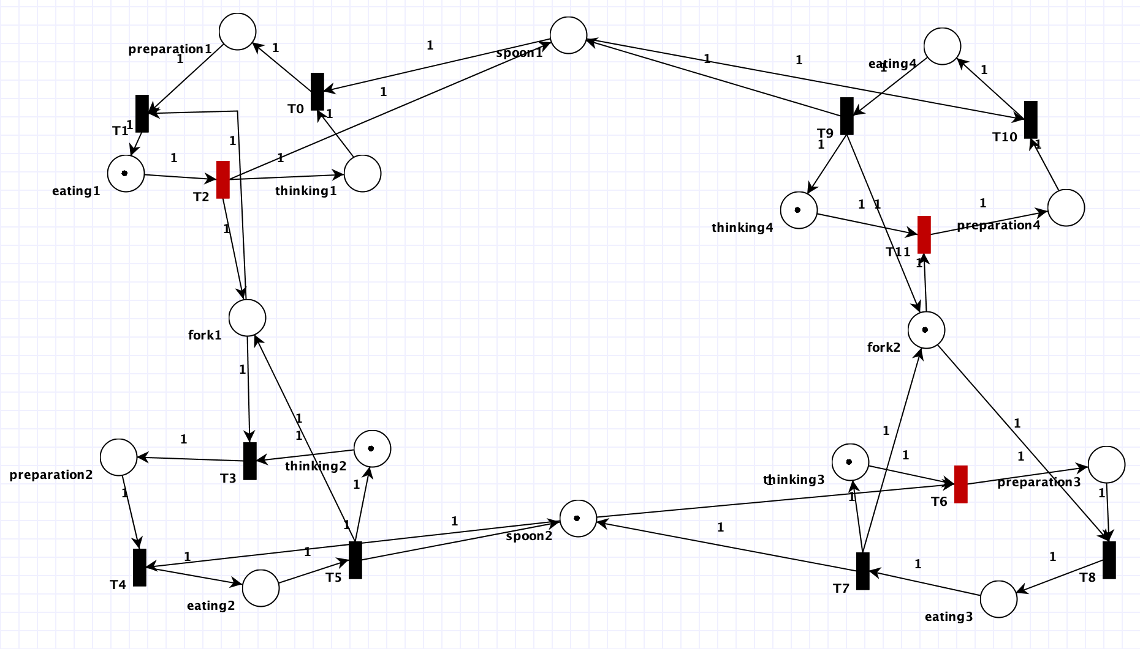
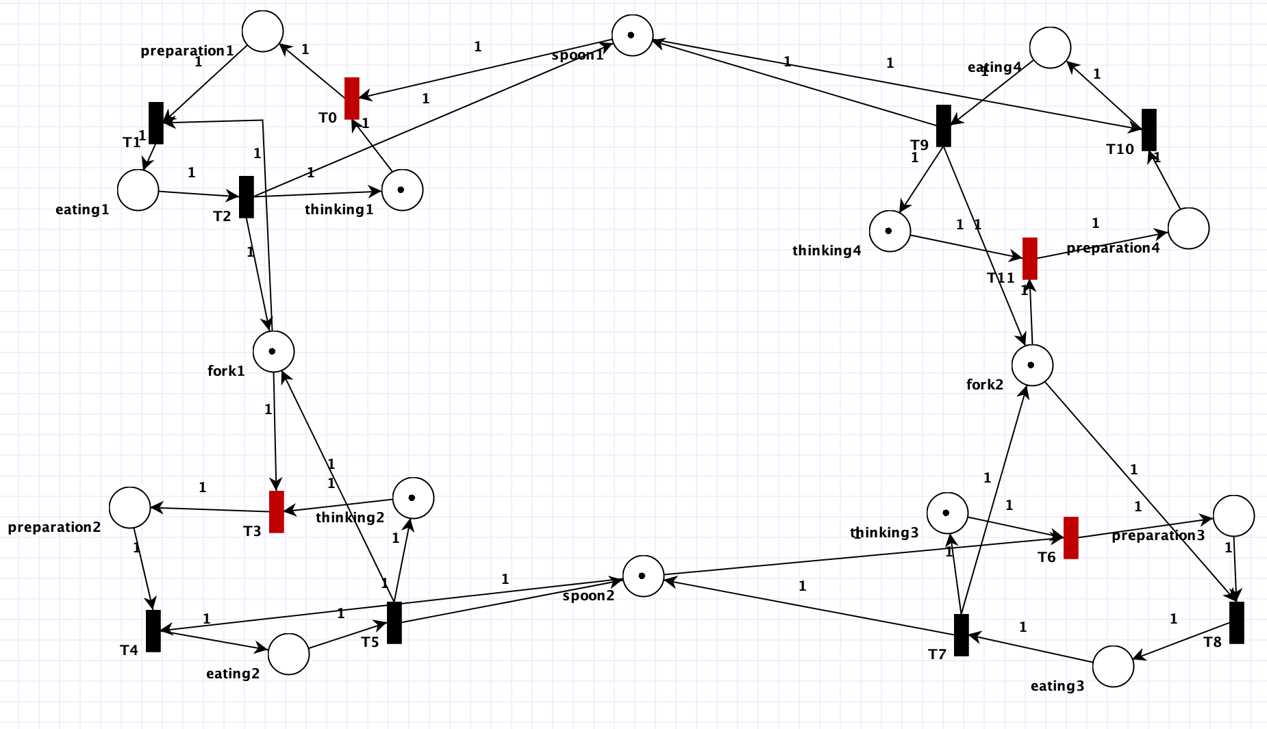
a Petri Net illustrating Dining Philosophers after several steps
step1
step2
step3
step4

Slide 19
References
Youtube (Dining Philosophers (1/3) - Modelled using Petri nets) (Dining Philosophers (2/3) - Modelled using Petri nets)
https://www.javatpoint.com/os-dining-philosophers-problem
https://www.javatpoint.com/os-dining-philosophers-problem
https://www.youtube.com/watch?v=EVh6qQCwwAM
John M. Jeffrey. 1991. Using Petri nets to introduce operating system concepts. SIGCSE Bull. 23, 1 (Mar. 1991), 324–329. https://doi.org/10.1145/107005.107074
David Garlan Carnegie Mellon University https://moodle.ucr.nl/pluginfile.php/96632/mod_page/content/30/24_petri_nets_1-1.pdf https://moodle.ucr.nl/pluginfile.php/96632/mod_page/content/30/25_petri_nets_2-1.pdf
Petri nets refresher Prof.dr.ir. Wil van der Aalst Eindhoven University of Technology, Faculty of Technology Management, Department of Information and Technology, P.O.Box 513, NL-5600 MB, Eindhoven, The Netherlands.

